Slide 1


Generative AI – Generation of Procedural Stories and/or for Computer Games Using Prompts
Student: Bogdan Radu Silviu Sielecki
Coordinating Professor: Ciprian Ionut Paduraru
Notes:
Good day, my name is Radu Sielecki.
My dissertation project is: "Generative AI –Generation of Procedural Storiesand/or for Computer Games Using Prompts"
In my paper I have explored how modern AI, particularly Large Language Models, can simulate dynamic storytelling in games – with characters that remember, reason and evolve through dialogue.

Slide 2
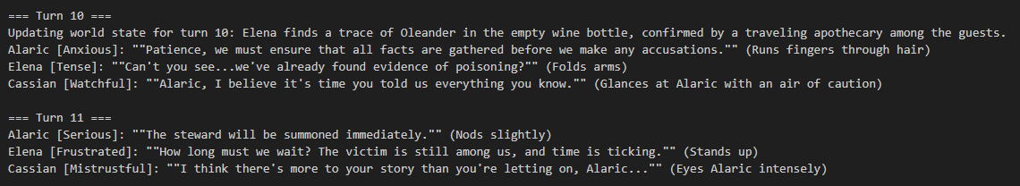
Application Idea
Simulates conversations between characters with memory and goals
Characters react to the environment (world state) and recall past experiences Useful for: RPG dialogue systems, narrative-driven games, interactive storytelling
Notes:
The core idea of this project is to simulate conversations between AI Agents (NPCs) who have their own personalities, memories and goals.
These NPCs should respond to world events changes and to each other in a way that creates a seemingly natural experience and an emergent narrative.
This would be especially useful for RPGs or narrative driven games where the NPCs dialogue could adapt in real time to the players previous or current actions or environment changes.
By enriching dialogue with AI, we can create game worlds where NPCs don’t just repeat pre-written lines — they react, remember, and evolve thus makes the world feel alive and responsive.
On the screen we can see an example of characters reacting to a world state update.
In the slide we have an example of how the characters react to a world state update. ('Elena finds a trace of Oleander in the empty wine bottle, confirmed by a traveling apothecary among the guests ')
In the RAG knowledge base every character knows that that Oleander is poisonous. And the comment "Can't you see... we've already found evidence of poisoning" from Elena is a strong evidence of RAG usage
Furthermore Cassian accused Alaric of knowing more than he let on because in Cassians memory 'He remembers seeing Oleander in the garden.' from the character initialization

Slide 3
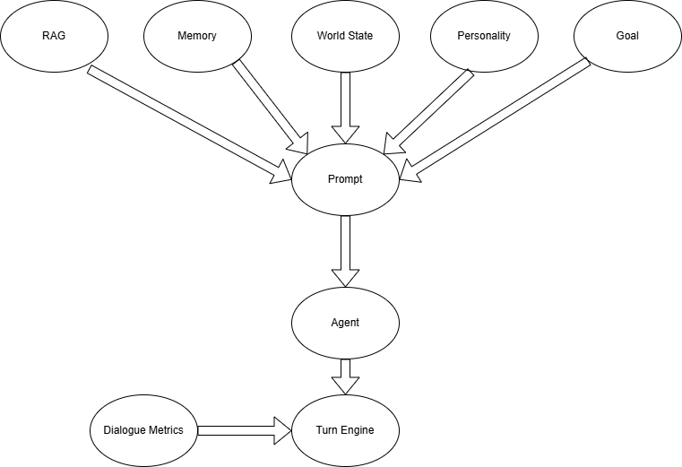
Technologies & Architecture
Python | Framework Simulation
RAG (Retrieval-Augmented Generation) | Context, world updates and common information
Ollama +(LLaMA 3.2, Deepseek, Gemini, Gemma) | Local LLMs for agent prompting
Agent | Creating characters with their own personalities, goals and memories
Turn Engine | Managing agent responses
Dialogue Metrics Logger | Evaluation (coherence, reactivity, memory usage)
Notes:
The system is build in Python and uses a modular architecture:
A simple RAG engine that . I used the RAG engine to store the world related knowledge or something that you could also refer as common knowledge.
Each Agent ('Character') is powered by a Large Language Model (LLama, Deepseek, Gemini or Gemma), running locally on Ollama.
Each agent has a custom-built prompt, composed of:
Goal gives narrative direction (e.g., deflect blame, reveal truth)
Personality determines the tone and style of the characters response.
world state anchors them in the current event (e.g., don’t sound cheerful after someone dies)
memory – holds past interactions and observations (e.g., "Cassian warned me about the wine"). Also at each character creation you can add character specific memories.
Retrieved facts from the RAG engine – injects world relevant information ('Such as that Oleander in large quantities is poisonous for example') .General knowledge, things that everyone from the scenario should know
A Turn Engine that manages the conversation flow — determining who speaks, when, and with what context. Through the turn engine you also update the world states and maintain the scenarios history.
Finally there is a Dialogue Metrics Logger integrated into the turn engine that analyses the Agents responses in real time and outputs objective metrics about the response.
Together, these modules simulate agents that talk, remember, and adapt based on the situation — allowing for complex, responsive dialogue between AI-controlled characters.

Slide 4
Contributions & Highlights
Technical Contributions:
Designed modular multi-agent simulation
Built memory-driven character behavior (episodic + semantic)
Developed scoring metrics (Reactivity, Memory Use, Dialogue Diversity, RAG Precision)
Narrative Contributions:
Scenario generation for moral choice, conflict, and emotional tension
Real-time story flow driven by AI + world events
Notes:
On the technical side, I implemented a multi-agent simulations with embedded personality, goals and memory.
I also build a scoring system to measure objective metrics about the LLM response such as:
(Coherence, World Changes Reactivity, Memory Utilization, Dialogue Diversity, RAG Precision)
On the narrative side, I designed scenarios where could test a various range of emotions (Emotional Tension, Environmental Surprise, Ambiguous Moral Choice and Conflict Resolution)
The goal of these scenarios was to observe whether the agents behave consistently with their character or if certain setups cause them to act irrationally or out of character.

Slide 5
Difficulties Encountered
Prompt tuning: getting consistent character behavior from LLMs
LLM hallucinations vs. grounded responses (even with RAG)
World state and memory blending needed fine control
Resource limitation in running local models
Notes:
During development, several challenges emerged that affected both the technical and narrative quality of the system.
The biggest challenge was prompt tuning , getting the AI characters to maintain consistent behavior. In early versions, agents would frequently hallucinate, even inventing entirely new characters and speaking from multiple perspectives within a single response.
Another issue was the lack of response structure. As the dialogue progressed, responses became increasingly long and unfocused, which also led to higher latency during simulation.
I also found that the agents alone don't proactively drive the story, they mostly react. Without frequent world state updates, the dialogue would lose momentum, becoming repetitive or flat. This made world modeling a critical and ongoing design task.
And finally, running models locally came with limitations. I was restricted in which LLMs I could test due to hardware constraints — particularly with newer, larger models.

Slide 6

Scenario - Murder Mystery
A noble guest collapses during a royal banquet. Lord Alaric is seated closest, drawing immediate suspicion. Three characters—each with different memories, goals, and knowledge—must react to the crisis.
Alaric: proud, manipulative noble (goal: deflect blame)
Elena: blunt mercenary (goal: protect others)
Cassian: secretive scholar (goal: expose the truth)
This scenario explores moral tension, loyalty, and how memory influences high-stakes decisions.
Coherence | 0.386
Reactivity | 0.142
Memory Utilization | 0.793
Dialogue Diversity | (0.594, 0.909)
Average Latency | 0.412
RAG Precision | 0.079

Slide 7
Scenario - Murder Mystery
A noble guest collapses during a royal banquet. Lord Alaric is seated closest, drawing immediate suspicion. Three characters—each with different memories, goals, and knowledge—must react to the crisis.
Alaric: proud, manipulative noble (goal: deflect blame)
Elena: blunt mercenary (goal: protect others)
Cassian: secretive scholar (goal: expose the truth)
This scenario explores moral tension, loyalty, and how memory influences high-stakes decisions.
Coherence | 0.386
Reactivity | 0.142
Memory Utilization | 0.793
Dialogue Diversity | (0.594, 0.909)
Average Latency | 0.412
RAG Precision | 0.079

Slide 8
Scenario - Murder Mystery
A noble guest collapses during a royal banquet. Lord Alaric is seated closest, drawing immediate suspicion. Three characters—each with different memories, goals, and knowledge—must react to the crisis.
Alaric: proud, manipulative noble (goal: deflect blame)
Elena: blunt mercenary (goal: protect others)
Cassian: secretive scholar (goal: expose the truth)
This scenario explores moral tension, loyalty, and how memory influences high-stakes decisions.
Coherence | 0.386
Reactivity | 0.142
Memory Utilization | 0.793
Dialogue Diversity | (0.594, 0.909)
Average Latency | 0.412
RAG Precision | 0.079

Slide 9
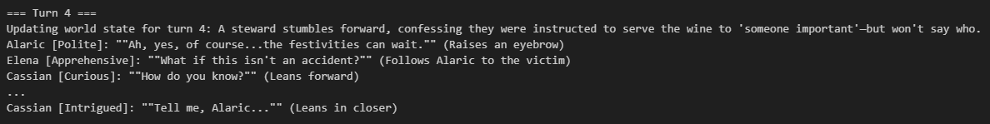
Scenario - Murder Mystery
A noble guest collapses during a royal banquet. Lord Alaric is seated closest, drawing immediate suspicion. Three characters—each with different memories, goals, and knowledge—must react to the crisis.
Alaric: proud, manipulative noble (goal: deflect blame)
Elena: blunt mercenary (goal: protect others)
Cassian: secretive scholar (goal: expose the truth)
This scenario explores moral tension, loyalty, and how memory influences high-stakes decisions.
Coherence | 0.386
Reactivity | 0.142
Memory Utilization | 0.793
Dialogue Diversity | (0.594, 0.909)
Average Latency | 0.412
RAG Precision | 0.079

Slide 10
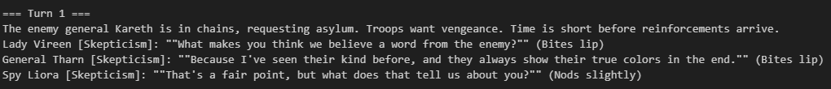
Scenario - Moral Ambiguity
Enemy general Kareth is in chains, requesting asylum. The army demands his execution, but the truth is more complicated. Three agents debate whether to show mercy or eliminate a threat.
Lady Vireen – noble, seeks justice (goal: balance survival and morality)
General Tharn – ruthless soldier (goal: execute the prisoner)
Spy Liora – pragmatic informant (goal: reveal hidden intel)
This scenario explores moral tension, loyalty, and how memory influences high-stakes decisions.
Coherence | 0.421
Reactivity | 0.190
Memory Utilization | 0.761
Dialogue Diversity | (0.522, 0.918)
Average Latency | 0.473
RAG Precision | 0.116

Slide 11
Scenario - Moral Ambiguity
Enemy general Kareth is in chains, requesting asylum. The army demands his execution, but the truth is more complicated. Three agents debate whether to show mercy or eliminate a threat.
Lady Vireen – noble, seeks justice (goal: balance survival and morality)
General Tharn – ruthless soldier (goal: execute the prisoner)
Spy Liora – pragmatic informant (goal: reveal hidden intel)
This scenario explores moral tension, loyalty, and how memory influences high-stakes decisions.
Coherence | 0.421
Reactivity | 0.190
Memory Utilization | 0.761
Dialogue Diversity | (0.522, 0.918)
Average Latency | 0.473
RAG Precision | 0.116

Slide 12
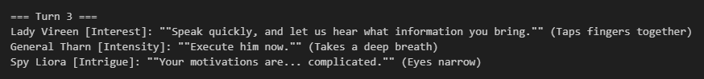
Scenario - Moral Ambiguity
Enemy general Kareth is in chains, requesting asylum. The army demands his execution, but the truth is more complicated. Three agents debate whether to show mercy or eliminate a threat.
Lady Vireen – noble, seeks justice (goal: balance survival and morality)
General Tharn – ruthless soldier (goal: execute the prisoner)
Spy Liora – pragmatic informant (goal: reveal hidden intel)
This scenario explores moral tension, loyalty, and how memory influences high-stakes decisions.
Coherence | 0.421
Reactivity | 0.190
Memory Utilization | 0.761
Dialogue Diversity | (0.522, 0.918)
Average Latency | 0.473
RAG Precision | 0.116

Slide 13
Scenario - Moral Ambiguity
Enemy general Kareth is in chains, requesting asylum. The army demands his execution, but the truth is more complicated. Three agents debate whether to show mercy or eliminate a threat.
Lady Vireen – noble, seeks justice (goal: balance survival and morality)
General Tharn – ruthless soldier (goal: execute the prisoner)
Spy Liora – pragmatic informant (goal: reveal hidden intel)
This scenario explores moral tension, loyalty, and how memory influences high-stakes decisions.
Coherence | 0.421
Reactivity | 0.190
Memory Utilization | 0.761
Dialogue Diversity | (0.522, 0.918)
Average Latency | 0.473
RAG Precision | 0.116

Slide 14
THANK YOU!
Q&A
Panel discussion session
Notes:
This project demonstrates how Generative AI can be used to create dynamic, procedural narratives through memory-driven, context-aware agents.
By combining world knowledge, character memory, and personality-based goals, we can simulate dialogue that is not only reactive but also rich in narrative depth.
An important insight from this project is that agents do not inherently push the story forward — instead, they respond to external changes such as world state updates.
This highlights the importance of narrative scaffolding: to maintain momentum, the environment must evolve in meaningful ways that the agents can interpret and react to.
One possible future direction would be to limit agent responses to a set of predefined options, allowing them to choose the most fitting one based on memory and goals. Additionally, introducing a separate orchestration agent could help decide how the story should progress after each decision, acting as a high-level narrator or director.
Despite challenges like prompt tuning and hallucinations, this system shows promising potential for building immersive, reactive storytelling in games and simulations.
Thank you for your attention. If there are any questions?

